Slide 1


Online Payments Fraud Detection with Python
By:
Niveda S Naik
Email:niveda.naik@outlook.com

Slide 2
TABLE OF CONTENTS
INTRODUCTION
DATASET DESCRIPTION
EXECUTIVE SUMMERY OF DATA
GRAPHICAL VISUALIZATION
MODEL EVALUATION
CONCLUSION

Slide 3
INTRODUCTION
Online Payments Fraud Detection is defined as a process that helps to detect the fraudulent activities while purchasing goods online. As we are approaching modernity, the trend of paying online is increasing tremendously. It is very beneficial for the buyer to pay online as it saves time, and solves the problem of free money. Also, we do not need to carry cash with us. But we all know that Good thing are accompanied by bad things.
The online payment method leads to fraud that can happen using any payment app. That is why Online Payment Fraud Detection is very important. Here we will try to solve this issue with the help of machine learning in Python.

Slide 4
DATASET DESCRIPTION
Feature | Description
step | tells about the unit of time
type | type of transaction done
amount | the total amount of transaction
nameOrg | account that starts the transaction
oldbalanceOrg | Balance of the account of sender before transaction
newbalanceOrg | Balance of the account of sender after transaction
nameDest | account that receives the transaction
oldbalanceDest | Balance of the account of receiver before transaction
newbalanceDest | Balance of the account of receiver after transaction
isFraud | The value to be predicted i.e. 0 or 1
Source of Data: https://www.kaggle.com/datasets
The dataset we will be using have these columns :

Slide 5
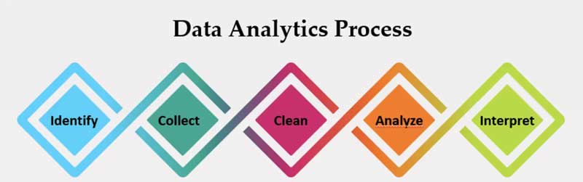
Executive Summery
The aim of this project is develop a model that will predict the online payment fraud.
The following steps need to be taken to predict the fraudulent scenario.
Exploratory Data analysis was carried out for proper visualization and understanding data distribution.

Slide 6
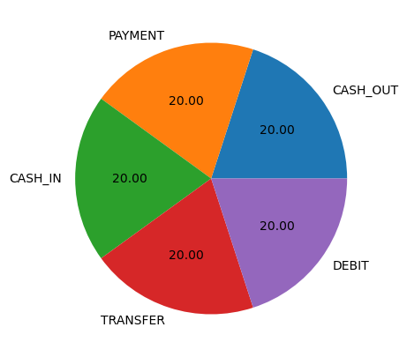
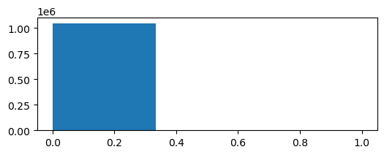
Graphical Visualization
The above graph is a pie chart that represents the different type of transaction and the total count of each transaction.
The above graph is a histogram that represents the distribution of Fraud cases.

Slide 7
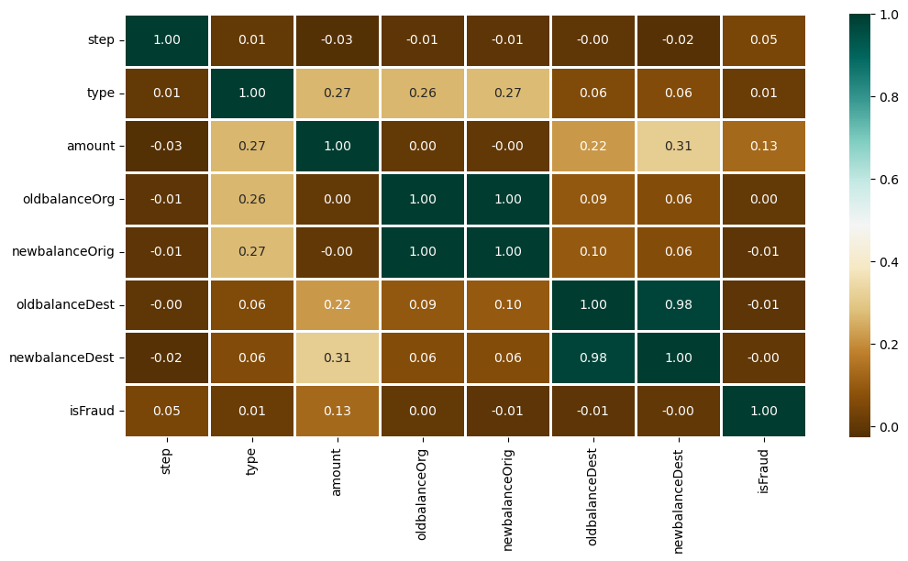
Graphical Visualization
The above graph is a Heatmap and it is used to see the correlation between columns of a dataset where we can use a darker color for columns having a high correlation. We can see there are multiple parameters which are highly correlated.

Slide 8
MODEL EVALUATION
After the Exploratory Data analysis, we need to apply the Machine learning algorithm to find the accuracy and the precision score of the model.
In this project, we have the classification model and we have used the Logistic Regression model and Decision Tree to evaluate the data.
Logistic Regression algorithm is a Supervised ML algorithm that is useful to predict binary or categorical value such as, Yes or No, True or False, Etc.
We have also used Decision Tree which creates a set of flow charts from a randomly selected subset of the training set. Then, it collects the votes from different decision trees to decide the final prediction.
Decision Tree is also a Supervised Machine learning algorithm, used for both classification and regression tasks.

Slide 9
Logistic Regression Model Report
 | Precision | Recall | F1 Score | Support
0 | 1.00 | 1.00 | 1.00 | 209497
1 | 0.51 | 0.39 | 0.44 | 218
Accuracy |  |  | 1.00 | 209715
Macro Avg. | 0.75 | 0.69 | 0.72 | 209715
Weighted Avg. | 1.00 | 1.00 | 1.00 | 209715
Decision Tree Model Report
 | Precision | Recall | F1 Score | Support
0 | 1.00 | 1.00 | 1.00 | 209497
1 | 0.85 | 0.86 | 0.86 | 218
Accuracy |  |  | 1.00 | 209715
Macro Avg. | 0.93 | 0.93 | 0.93 | 209715
Weighted Avg. | 1.00 | 1.00 | 1.00 | 209715

Slide 10
CONCLSION
Fraudsters focus during cashout and transfer mode type transfer.
After applying the Logistic Regression mode, we got 99.89 % accuracy score and 50.84% precision score.
There is not much information taken from oldbalanceOrg, newbalanceOrig, nameDest, oldbalanceDest and newbalanceDest columns though they had good positive correlation score.
After applying both the models, we found that Decision Tree is the best fit model that can be used for this project analysis.
Although the accuracy is 100% in both models, the Precision and recall has improved results in decision tree model.

Slide 11
Thank You

